Slide 1

WebRTC
Optimizing the Critical Rendering Path
nuts and bolts of delivering instant mobile websites
Ilya Grigorik - @igrigorik
Make The Web Fast
Google

Slide 2

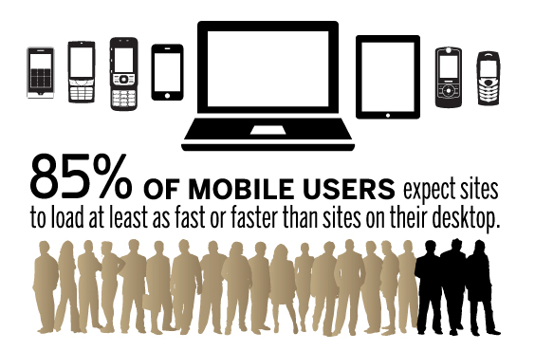
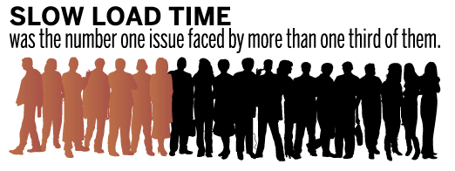

Impact of poor performance...
Impact of 1-second delay - Strangeloop
@igrigorik

Slide 3
Speed is a feature.

Slide 4
2
Critical rendering path: resource loading
HTML
DOM
Network
JavaScript
Render Tree
Layout
Paint
CSS
CSSOM
1
Latency, bandwidth and 3G / 4G architecture and constraints
@igrigorik

Slide 5
Delay | User reaction
0 - 100 ms | Instant
100 - 300 ms | Slight perceptible delay
300 - 1000 ms | Task focus, perceptible delay
1 s+ | Mental context switch
10 s+ | I'll come back later...
1000 ms time to glass challenge
Simple user-input must be acknowledged within ~100 milliseconds.
To keep the user engaged, the task must complete within 1000 milliseconds.
Ergo, our pages should render within 1000 milliseconds.
Speed, performance and human perception
@igrigorik

Slide 6
Networking constraints...
4G will make all things fast... right? right?

Slide 7
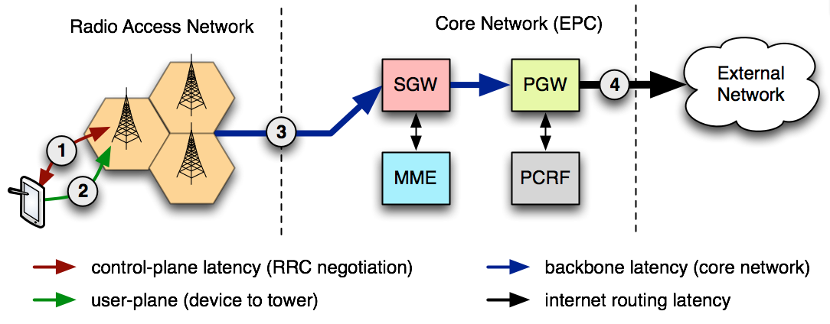
Outbound data-flow (4G)
 | LTE | HSPA+ | HSPA | EDGE | GPRS
AT&T core network latency | 40-50 ms | 50-200 ms | 150-400 ms | 600-750 ms | 600-750 ms
* Core network latencies vary from carrier to carrier...
@igrigorik

Slide 8
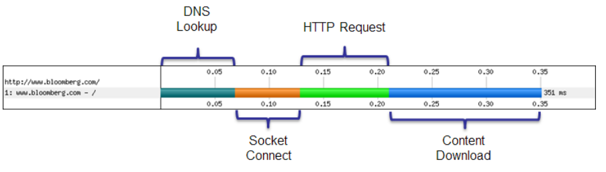
The (short) life of a web request
(Worst case) DNS lookup to resolve the hostname to IP address
(Worst case) New TCP connection requiring a full roundtrip to the server
(Worst case) TLS handshake with up to two extra server roundtrips!
HTTP request requiring a full roundtrip to the server
Server processing time
@igrigorik

Slide 9

The (short) life of our 1000 ms budget
 | 3G (200 ms RTT) | 4G(100 ms RTT)
Control plane | (200-2500 ms) | (50-100 ms)
DNS lookup | 200 ms | 100 ms
TCP Connection | 200 ms | 100 ms
TLS handshake | (200-400 ms) | (100-200 ms)
HTTP request | 200 ms | 100 ms
Leftover budget | 0-400 ms | 300-700 ms
Network overhead of one HTTP request!
@igrigorik

Slide 10
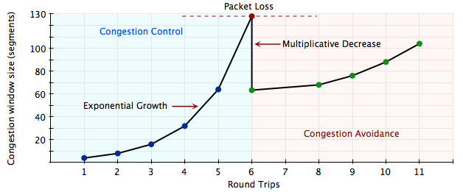
TCP Congestion Control & Avoidance...
TCP is designed to probe the network to figure out the available capacity
TCP does not use full bandwidth capacity from the start!
TCP Slow Start is a feature, not a bug.
Congestion Avoidance and Control
@igrigorik

Slide 11
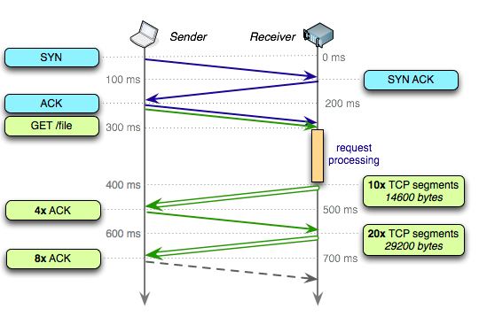
Let's fetch 40 KB over a new TCP connection
5 Mbps connection
200 ms roundtrip time
100 ms server processing time
IW10 means ~14KB in first RTT
3 roundtrips, or 700 ms!
plus DNS and TLS roundtrips ...
Congestion Avoidance and Control
@igrigorik

Slide 12
Breaking the 1000 ms time to glass mobile barrier...
~50% of the budget is in network latency overhead
100-200 ms RTT's for DNS, TCP, TLS, HTTP
Must account for TCP slow start
Best case scenario: one RTT render *
~14 KB of data, delivered in one roundtrip
no time or place for redirects, eliminate them!
* We don't need to render the full page! We need to render the above the fold content.

Slide 13
What's the critical rendering path?
To answer that, we need to peek inside the browser...

Slide 14

Let's try a simple example...
index.html
<!doctype html><meta charset=utf-8><title>Performance!</title><link href=styles.css rel=stylesheet /><p>Hello <span>world!</span></p>
styles.css
p { font-weight: bold; }
span { display: none; }
Simple (valid) HTML file
External CSS stylesheet
What could be simpler, right?
@igrigorik

Slide 15

HTML bytes are arriving on the wire...
index.html
<!doctype html><meta charset=utf-8><title>Performance!</title><link href=styles.css rel=stylesheet /> <p>Hello <span>world!</span></p>
first response packet with index.html bytes
we have not discovered the CSS yet...
HTML
DOM
Network
Render Tree
styles.css
p { font-weight: bold; }
span { display: none; }
CSS
CSSOM
We're splitting packets for convenience...
@igrigorik

Slide 16
DOM construction is complete... waiting on CSS!
index.html
<!doctype html><meta charset=utf-8><title>Performance!</title><link href=styles.css rel=stylesheet /><p>Hello <span>world!</span></p>
<link> discovered, network request sent
DOM construction complete!
HTML
DOM
DOM
Network
Render Tree
styles.css
p { font-weight: bold; }
span { display: none; }
CSS
CSSOM
screen is blank, blocked on CSS
otherwise, flash of unstyled content
@igrigorik

Slide 17
First CSS bytes arrive... still waiting on CSS!
index.html
<!doctype html><meta charset=utf-8><title>Performance!</title><link href=styles.css rel=stylesheet /><p>Hello <span>world!</span></p>
First CSS bytes arrive
But, we must wait for the entire file...
HTML
DOM
DOM
Network
Render Tree
styles.css
p { font-weight: bold; }
span { display: none; }
CSS
CSSOM
Unlike HTML parsing, CSS is not incremental
@igrigorik

Slide 18
Finally, we can construct the CSSOM!
index.html
<!doctype html><meta charset=utf-8><title>Performance!</title><link href=styles.css rel=stylesheet /><p>Hello <span>world!</span></p>
CSS download has finished - yay!
We can now construct the CSSOM
HTML
DOM
DOM
Network
Render Tree
styles.css
CSS
CSSOM
p { font-weight: bold; }
span { display: none; }
CSSOM
still blank :(
@igrigorik

Slide 19
Critical rendering path
HTML
DOM
Network
Render Tree
Layout
Paint
CSS
CSSOM
Once render tree is ready, perform layout
aka, compute size of all the nodes, etc
Once layout is complete...
Render pixels on the CPU
Transfer bitmaps to GPU
Display page! (yay)
Hello
~100 ms
@igrigorik

Slide 20
Performance rules to keep in mind...
(1) HTML is parsed incrementally
(2) Rendering is blocked on CSS...
Which means...
(1) Stream the HTML response to the client
Don't wait to render the full HTML file - flush early, flush often.
(2) Get CSS down to the client as fast as you can
Unblocks paints, removes potential JS waiting on CSS scenario

Slide 21
Err, wait. Did we forget something?
How about that JavaScript thing...

Slide 22
JavaScript... our friend and foe.
index.html
<!doctype html><meta charset=utf-8><title>Performance!</title>
<script src=application.js></script><link href=styles.css rel=stylesheet /><p>Hello <span>world!</span></p>
In some ways, JS is similar to CSS, except ...
HTML
DOM
DOM
elem.style.width = "500px"
Network
JavaScript
styles.css
CSS
CSSOM
p { font-weight: bold; }
span { display: none; }
CSSOM
JavaScript can query (and modify) DOM, CSSOM!
@igrigorik

Slide 23
JavaScript performance pitfalls...
JavaScript can query CSSOM
JavaScript can block on CSS
JavaScript can modify CSSOM
JavaScript can query DOM
JavaScript can block DOM construction
JavaScript can modify DOM
application.js
<script>
var old_width = elem.style.width;
elem.style.width = "300px";
document.write("I'm awesome")
</script>

Slide 24

Critical rendering path
HTML
DOM
Network
JavaScript
Render Tree
Layout
Paint
CSS
CSSOM
(1) Stream the HTML to the client
Allows early discovery of dependent resources (e.g. CSS / JS / images)
(2) Get CSS down to the client as fast as you can
Unblocks paints, removes potential JS waiting on CSS scenario
(3) Eliminate blocking JavaScript
Faster DOM construction, faster DCL and paint!
Do you need scripts in your critical rendering path?

Slide 25
Recipe for Instant Mobile Site
let's pull it all together now...

Slide 26



We don't need to render the entire page...
We need to render above the fold content!
One RTT render for above the fold!
No redirects + fast server response (<200 ms)
Must optimize critical rendering path
Inline critical CSS
Remove blocking JavaScript
@igrigorik

Slide 27
<html>
<head>
<link rel="stylesheet" href="all.css">
<script src="application.js"></script>
</head>
<body>
<div class="main">
Here is my content.
</div>
<div class="leftnav">
Perhaps there is a left nav bar here.
</div>
...
</body>
</html>
Split all.css, inline AFT styles
Do you need the JS at all?
Progressive enhancement
Inline AFT JS code
Defer the rest

Slide 28
<html>
<head>
<style>
.main { ... }
.leftnav { ... }
/* ... any other styles needed for the initial render here ... */
</style>
<script>
// Any script needed for initial render here.
// Ideally, there should be no JS needed for the initial render
</script>
</head>
<body>
<div class="main">
Here is my content.
</div>
<div class="leftnav">
Perhaps there is a left nav bar here.
</div>
<script>
function run_after_onload() {
load('stylesheet', 'remainder.css')
load('javascript', 'remainder.js')
}
</script>
</body>
</html>
Above the fold CSS
Above the fold JS
(ideally, none)
Paint the above the fold, then load the rest.

Slide 29
Breaking the 1000 ms time to glass mobile barrier...
Inline the above the fold CSS and JavaScript
Keep it small and lightweight: under 14 KB for IW10
Defer non-critical assets
Eliminate JavaScript from the critical rendering path
Watch out for extra round-trips!
And especially new connections: DNS, TCP, TLS, ...
Put your critical assets on the same domain!
* We don't need to render the full page! We need to render the above the fold content.

Slide 30
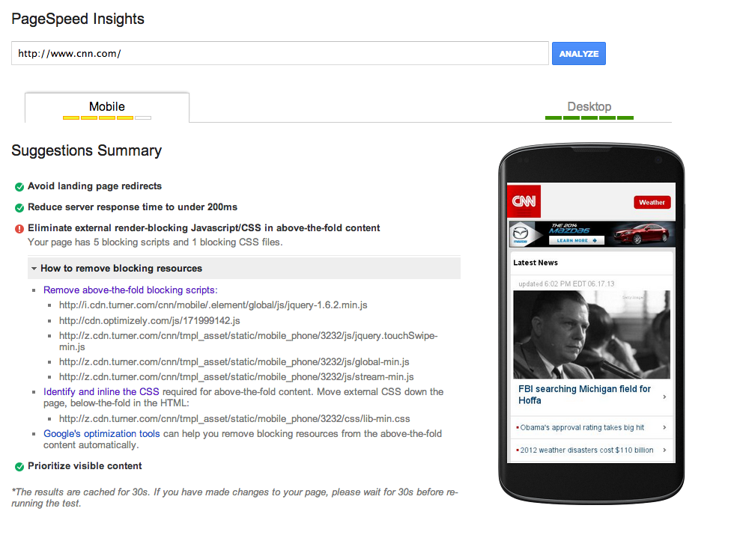
Demo!

Slide 31
Building instant mobile sites
How do I optimize my critical rendering path?

Slide 32
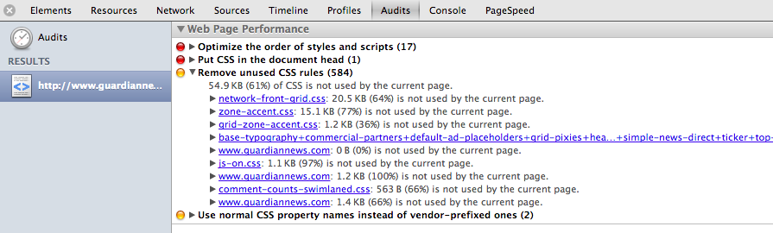
Identify critical CSS via an Audit (Manual)
DevTools > Audits > Web Page Performance
Inline the critical styles...
@igrigorik

Slide 33

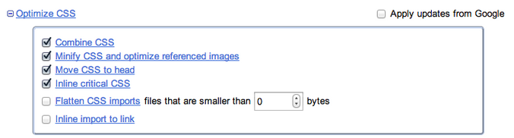
(1) Renders page on the Google servers...
Render and critical CSS calculation done "out of band"
(2) Critical CSS is inlined on next page view...
Critical CSS is inlined on next page view
Remaining CSS loaded after first paint

Slide 34


+
(1) Client renders page, custom JS beacons back ATF CSS styles
PageSpeed gathers critical CSS beacons from visitors
(2) Critical CSS is inlined...
Remaining CSS loaded after first paint
ModPagespeedEnableFilters prioritize_critical_css # Apache
pagespeed EnableFilters prioritize_critical_css # Nginx
modpagespeed.com
ngxpagespeed.com
https://developers.google.com/speed/pagespeed/module/filter-prioritize-critical-css

Slide 35
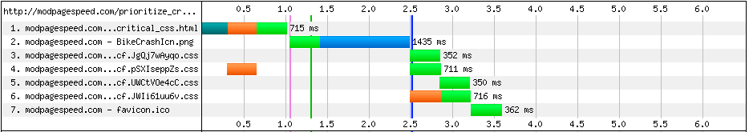
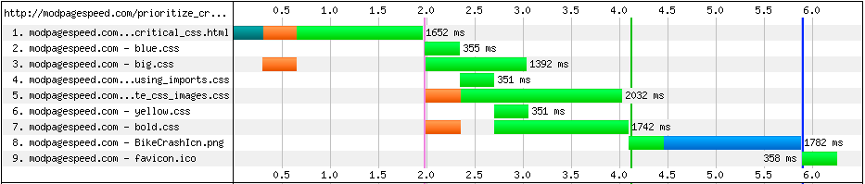
prioritize_critical_css
original
First render @ 1.3s
WebPageTest comparison
First render @ 4.1s

Slide 36
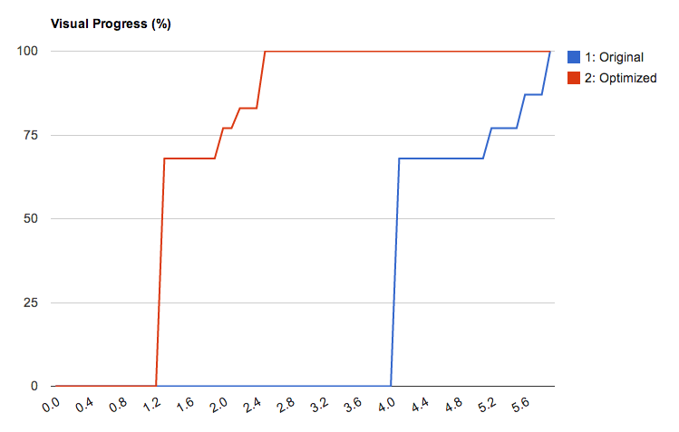
PageSpeed office hours @ Google booth! Stop by to learn more and ask us questions...
WebPageTest comparison
@igrigorik

Slide 37
~50% of the budget is in network latency overhead
100-200 ms RTT's, must account for TCP slow start (~14KB).
Best case scenario: one RTT render *
Focus on delivering the above the fold content in first RTT!
Inline the above the fold CSS and JavaScript
Not everything! Just the critical ATF content.
Defer non-critical assets
Eliminate JavaScript from the critical rendering path.
Watch out for extra round-trips!
And especially new connections: DNS, TCP, TLS, ...

Slide 38
Questions?
Slides @ bit.ly/mobilecrp
G+ google.com/+IlyaGrigorik
Twitter @igrigorik
Web igvita.com

